Slide 1

COST
Probability Theory

Slide 2
Revision Shape of The Ditribution
Skewness
2
Raw Moments
1
Central Moments
Positively skewed
Negatively skewed
Kurtosis
3
Leptokurtic
Mesokurtic
Platykurtic
Raw Moments

Slide 3
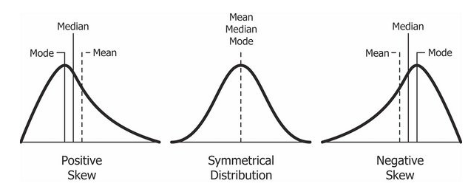
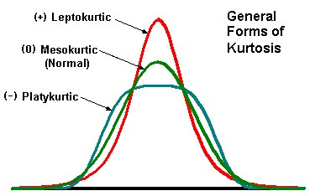
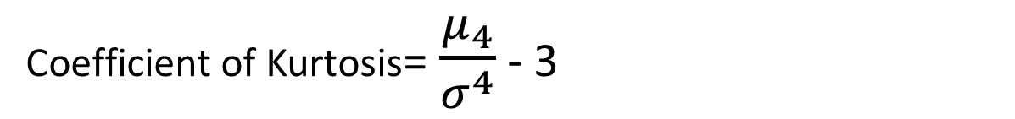
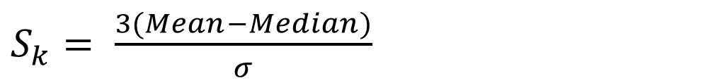
Skewness
$S_{k}= \frac{3(Mean−Median)}{σ}$
Coefficient of Kurtosis= $\frac{μ_{4}}{σ^{4}}$ - 3

Slide 4

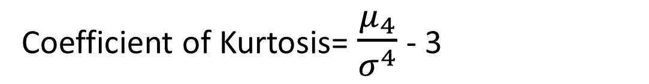
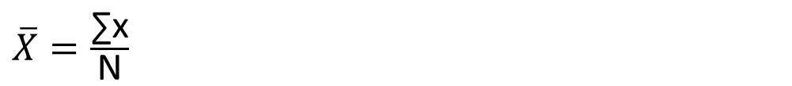

Questions
Define kurtosis. Compute coefficient of kurtosis for the following observations 2, 3, 5, 7, 4, 8, 1.
Also comment on result.
Solution-
Formula-
$$μ_{4}=\frac{\sum{{\left(X−\overline{X}\right)}^{4}}}{N}$$
$\overline{X}=\frac{\text{∑}\text{x}}{\text{N}}$
Coefficient of Kurtosis= $\frac{μ_{4}}{σ^{4}}$ - 3
$$S.D=σ=\sqrt{\frac{\sum{{(X−\overline{X)}}^{2}}}{N}}$$

Slide 5

Relation between raw moments and central moments
$μ_{1}^{′}=$ $\overline{X}$= Arithmetic Mean
$${ μ}_{1}=0$$
$${ μ}_{2}=μ_{2}^{′}−( {μ_{1}^{′})}^{2}$$
$${ μ}_{3}=μ_{3}^{′}−3 μ_{1}^{′}μ_{2}^{′}+2( {μ_{1}^{′})}^{3}$$
$${ μ}_{4}=μ_{4}^{′}−4 μ_{1}^{′}μ_{3}^{′}+6( {μ_{1}^{′})}^{2}μ_{2}^{′}−3( {μ_{1}^{′})}^{4}$$

Slide 6
Questions
If first four raw moments of a data set are 7.2, 96.4, 289.72 and 4588.36 respectively, then find first four central moments.
If first four raw moments of a data set are 5, 75, 356 and 2560 respectively, then find first four central moments.

Slide 7
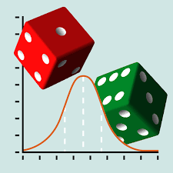
Probability Theory

Slide 8
Sample Space S
Set of all possible outcomes.
Tossing a coin
Outcomes S ={Head, Tail}
Rolling a die
Outcomes S={1, 2, 3, 4, 5, 6}

Slide 9
Event E
Subset of the sample space S.
Any set of outcomes
S
Venn diagram
E

Slide 10
Examples
Rolling a die – outcomes
S ={ , , , , , }
={1, 2, 3, 4, 5, 6}
E = the event that an even number is rolled
= {2, 4, 6}
={ , , }

Slide 11
Special Events
The null event, the empty event - φ
φ = { } = the event that contains no outcomes
The entire event, the sample space - S
S = the event that contains all outcomes
The empty event, φ , never occurs.
The entire event, S, always occurs.

Slide 12
Special Events
The null event, the empty event - φ
φ = { } = the event that contains no outcomes
The entire event, the sample space - S
S = the event that contains all outcomes

Slide 13
Set operations on Events
Union
Intersection
Complement

Slide 14
Union
Let A and B be two events, then the union of A and B is the event (denoted by A∪B) defined by:
A ∪ B = {A or B}
A ∪ B
A
B

Slide 15
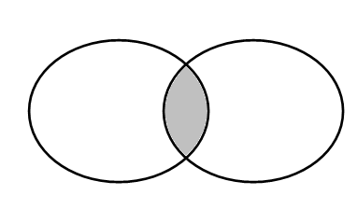
Intersection
Let A and B be two events, then the intersection of A and B is the event (denoted by A∩B) defined by:
A ∩ B = {A and B}
A ∩ B
A
B

Slide 16
Complement
Let A be any event, then the complement of A (denoted by ) defined by:
= {not (A)}
A

Slide 17
Mutually exclusive events
Two events A and B are called mutually exclusive if:
A
B
They have no outcomes in common.
They can’t occur at the same time.

Slide 18
Probability of an Event E
Suppose that the sample space S has N number of outcomes.
Then for any event E

Slide 19
Examples
If a coin is tossed, what is a probability of getting head?
If a die is thrown, what is the probability of getting even number?
If a card is drawn from a pack of 52 cards, what is the probability of getting spade card?

